Slide 1
CS 5520 Overview
Dr. Dan Feinberg

Slide 2
Mobile Devices
battery
CPU
memory
storage
screen
input hardware
data
battery

Slide 3
Designing Mobile Apps
Not just coding apps
using sensors, respecting limitations
carry it with you
smooth, predictable UI
user engagement

Slide 4
User Engagement
Smooth, predictable UI
Doing things they don’t want to do
More than games & gamification
Game notifications -> Facebook -> Banking app

Slide 5
Platform
Transcending platform, beyond next few years
Android – Google Play store friendlier to beginners
iPhone big in US, Android big globally
Java, not Kotlin
Easier for beginners
More exisiting projects

Slide 6
Hardware
Mac or Windows
Physical device, not emulator
faster, experience sensors

Slide 7
Google Developer Account
For submitting to Google Play Store
$25
credit card
Optional

Slide 8
Expectations
Review syllabus
Watch lectures & read
(Reference readings not meant to be read completely)
Try writing code
12-15 hours, 4 credit hours
Don’t wait until Sunday, especially discussions

Slide 9
Online Course
Canvas
Disscussion vs. Piazza vs. email
private code
people asking same question
Timestamp on videos
Don’t hijack threads
Participation

Slide 10
Assignments
Individual assignments
Group project – designing and coding
Work in groups
Don’t copy and paste

Slide 11

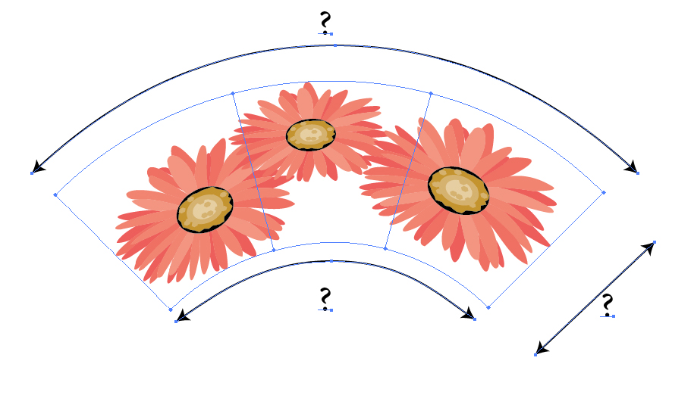
I built that

